Slide 1



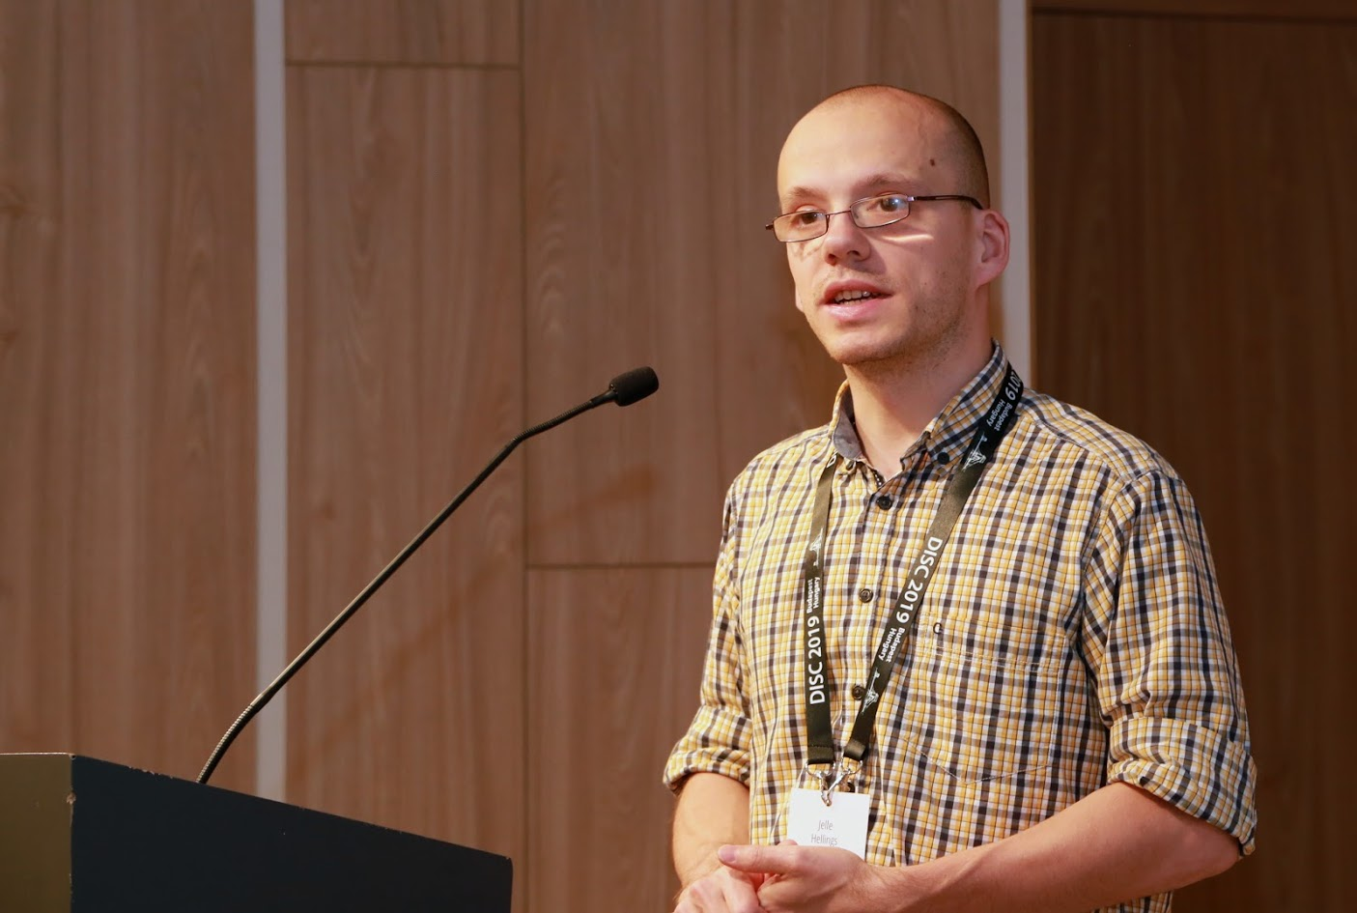


Building High Throughput Permissioned Blockchain Fabrics: Challenges and Opportunities
Suyash Gupta
Jelle Hellings
Sajjad Rahnama
Mohammad Sadoghi
Exploratory Systems Lab
University of California Davis

Slide 2




At the core of any Blockchain application is a Byzantine Fault-Tolerant (BFT) consensus protocol.
OK
OK
Order Txn
OK

Slide 3
Practical Byzantine Fault-Tolerance (PBFT) [OSDI’99]
First practical Byzantine Fault-Tolerant Protocol.
Tolerates up to f failures in a system of 3f+1 replicas
Requires three phases of which two necessitate quadratic communication complexity.
Safety is always guaranteed and Liveness is guaranteed in periods of partial synchrony.

Slide 4
PBFT Civil Executions
Client
T
Primary
Replica 1
Replica 2
Byzantine
Replica
Client
Request
Pre-Prepare
O(n)
Prepare
O(n²)
Commit
O(n²)
Reply
Execute

Slide 5
PBFT Uncivil Execution: Primary Failure (View Change)
Got VC message from Majority?
New Primary
Replica 1
Replica 2
Byzantine Primary
View Change Message
New View Message
Enter New View

Slide 6
Speculative Byzantine Fault Tolerance (Zyzzyva)
[SOSP’07]
Speculation to achieve consensus in a single phase.
Under no failures, it only requires linear communication complexity.
Requires good clients, for ensuring same order across the replicas.
Clients need matching responses from all the 3f+1 replicas.
Just one crash failure is sufficient to severely impact throughput.
Recently, proven unsafe!

Slide 7
Zyzzyva Civil Executions
Client needs
3f+1 responses
Client
T
Primary
Replica 1
Replica 2
Replica 3
Client
Request
Pre-prepare
Reply
Speculative Execution

Slide 8
Zyzzyva under Failure of one Non-Primary Replica
Client
Timeouts
Client
T
Primary
Replica 1
Replica 2
Byzantine Replica
Client
Request
Pre-prepare
Reply
Commit
Certificate
Certificate
Reply
On client timeout → switches to slow-path.

Slide 9
SBFT: A Scalable and Decentralized Trust Infrastructure
[DSN’19]
A safe alternate to Zyzzyva.
Employs threshold signatures to linearize consensus → Splits each O(n²) phase of PBFT into two linear phases.
Requires twin-paths → fast-path and slow-path.
Introduces notion of collectors and executors.

Slide 10
SBFT Civil Execution
Client
Primary
Replica
Collector
Executor
Client Request
Pre-prepare
Sign-share
Commit-Proof
Sign-state
Execute-Proof
Either no failures or c+1 crash failures for c > 0 collectors if n = 3f+2c+1

Slide 11
Hotstuff: BFT Consensus in the Lens of Blockchain
[PODC’19]
Splits each O(n²) phase of PBFT into two linear phases.
Advocates leaderless consensus → Frequent primary replacement.
Employs threshold signatures to linearize consensus → enforces sequential processing.
Two versions:
Basic Hotstuff: Primary switched at the end of each consensus.
Chained Hotstuff: Employs pipelining to ensure each phase run by a distinct primary.

Slide 12
Hotstuff Protocol
Primary
Replica 1
Replica 2
Byzantine
Replica
View
change
Proposal
Prepare
vote
Pre-commit
Message
Pre-commit
Vote
Commit
Message
Commit
Vote
Decide
Prepare
Phase
Pre-Commit
Phase
Commit Phase

Slide 13
Other Proposed Byzantine-Fault Tolerant Designs
System consisting of n >> 3f+1.
Q/U [SOSP’05] expects 5f+1 replicas.
Use of trusted components to prevent primary equivocation.
AHL [SIGMOD’19]

Slide 14
Novel Byzantine Fault-Tolerant Protocols

Slide 15
Speculative Execution
Proof-of-Execution (PoE)
Three-phase Linear protocol
Out-of-Order Message Processing
No dependence on clients or trusted component.
No reliance on a twin-path design.

Slide 16
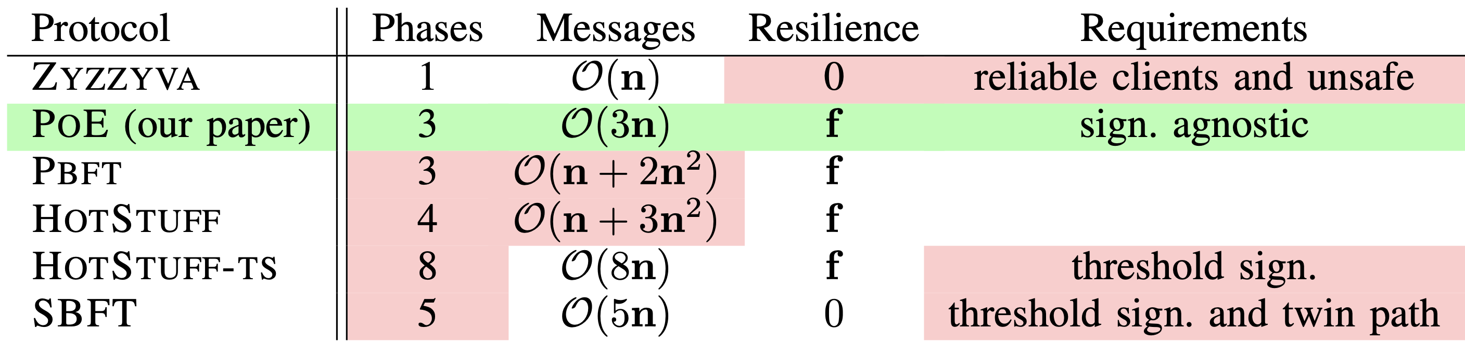
PoE vs Other Protocols

Slide 17
Proof-of-Execution (PoE)
Client
T
Primary
Replica 1
Replica 2
Byzantine
Replica
Client
Request
Pre-Prepare
Prepare
Certify
Reply
Execute
n = 4 replicas and f <= 1

Slide 18
PoE View Change Protocol
New Primary
Replica 1
Replica 2
Byzantine Primary
View Change Request
Join after Receiving
f+1 VC requests
New View
Propose
Enter
New View

Slide 19
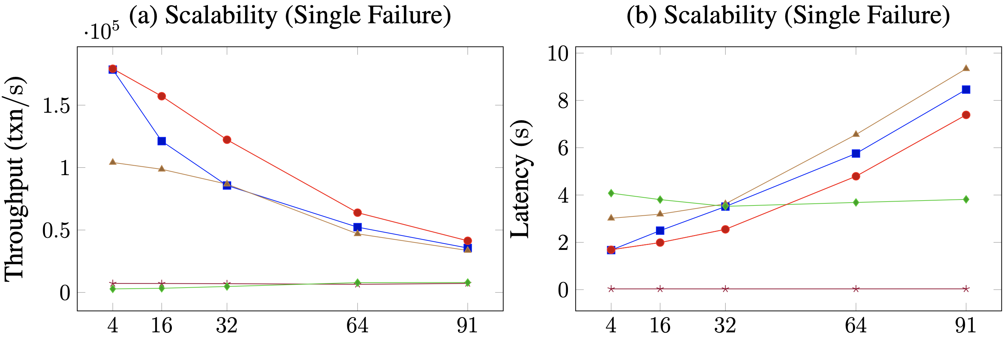

PoE Scalability under Single Failure

Slide 20
Resilient Concurrency Control (RCC) Paradigm
Democracy → Give all the replicas the power to be the primary.
Parallelism → Run multiple parallel instances of a BFT protocol.
Decentralization → Always there will be a set of ordered client requests.

Slide 21
RCC Defense
Why should BFT protocols rely on just one primary replica?
Malicious primary can throttle the system throughput.
Malicious primary requires replacemenat → fall in throughput.

Slide 22
Resilient Concurrency Control Paradigm
Parallelism
Ordering
Execution
BFT protocol
Run z parallel BFT
instances.
Create a global order
of all the requests.
Execute the requests
in a global order.
Number of
Instances (z)
RCC can employ several BFT protocols: PBFT, Zyzzyva, SBFT and PoE.

Slide 23
Client
T
1
Primary
Replica
2
1
Replica
2
Client
T
Primary
Replica
1
2
Byzantine
Replica
1
2
Request
Pre-Prepare
Prepare
Commit
Reply
RCC using PBFT with 2 parallel instances on each replica

Slide 24
Colluding Primaries
Multiple malicious primaries can prevent liveness!
Solution → Optimistic Recovery through State Exchange.
Good Replicas
|A| = f
Good Replica
|C| = 1
Good Replicas
|B| = f
m₁
m₂
P₁
|M| = f
P₂
Other f-2
Malicious Replicas

Slide 25
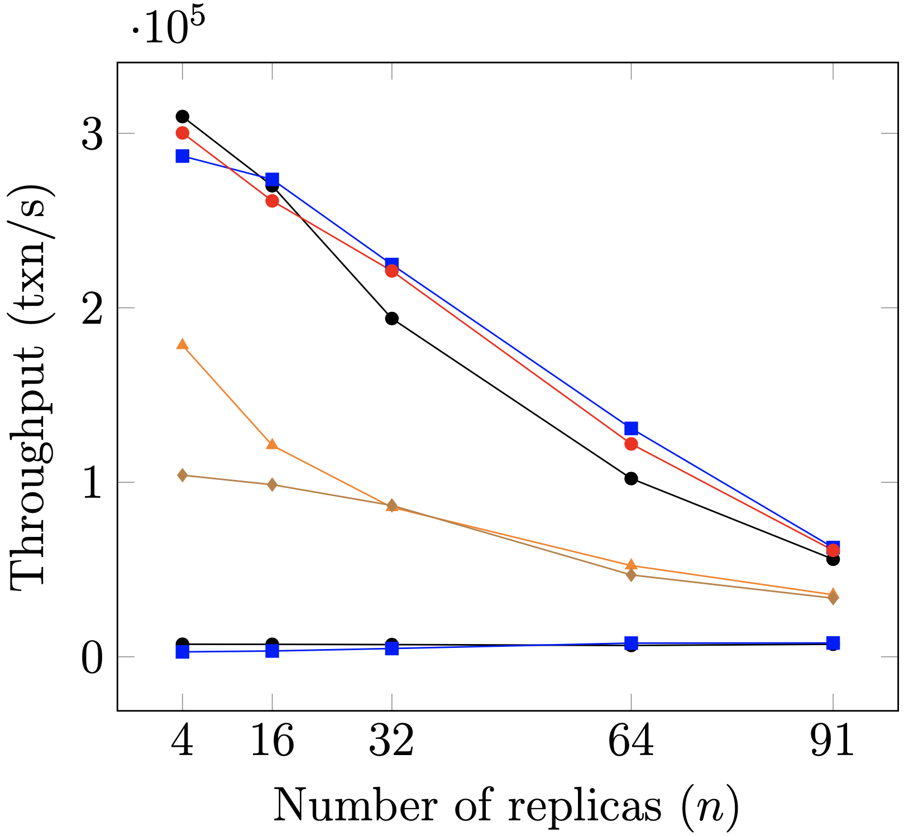

Scalability
26x
Single Failure Experiments

